Slide 1

Welcome
to
Basha High
2023 - 2024

Slide 2

Blood
Drive
Reminder - National Honor Society is having our second blood drive on December 5th in the small gym. If you are interested in donating, please use the following link to sign up. Again, we appreciate your support and hope to see you there! 😊
https://donors.vitalant.org/dwp/portal/dwa/appointment/guest/phl/timeSlotsExtr?token=jrb48fhc2aIf2tm9KxOhCVf9CPKphJY8B4FZVsVYYAQ%3D

Slide 3
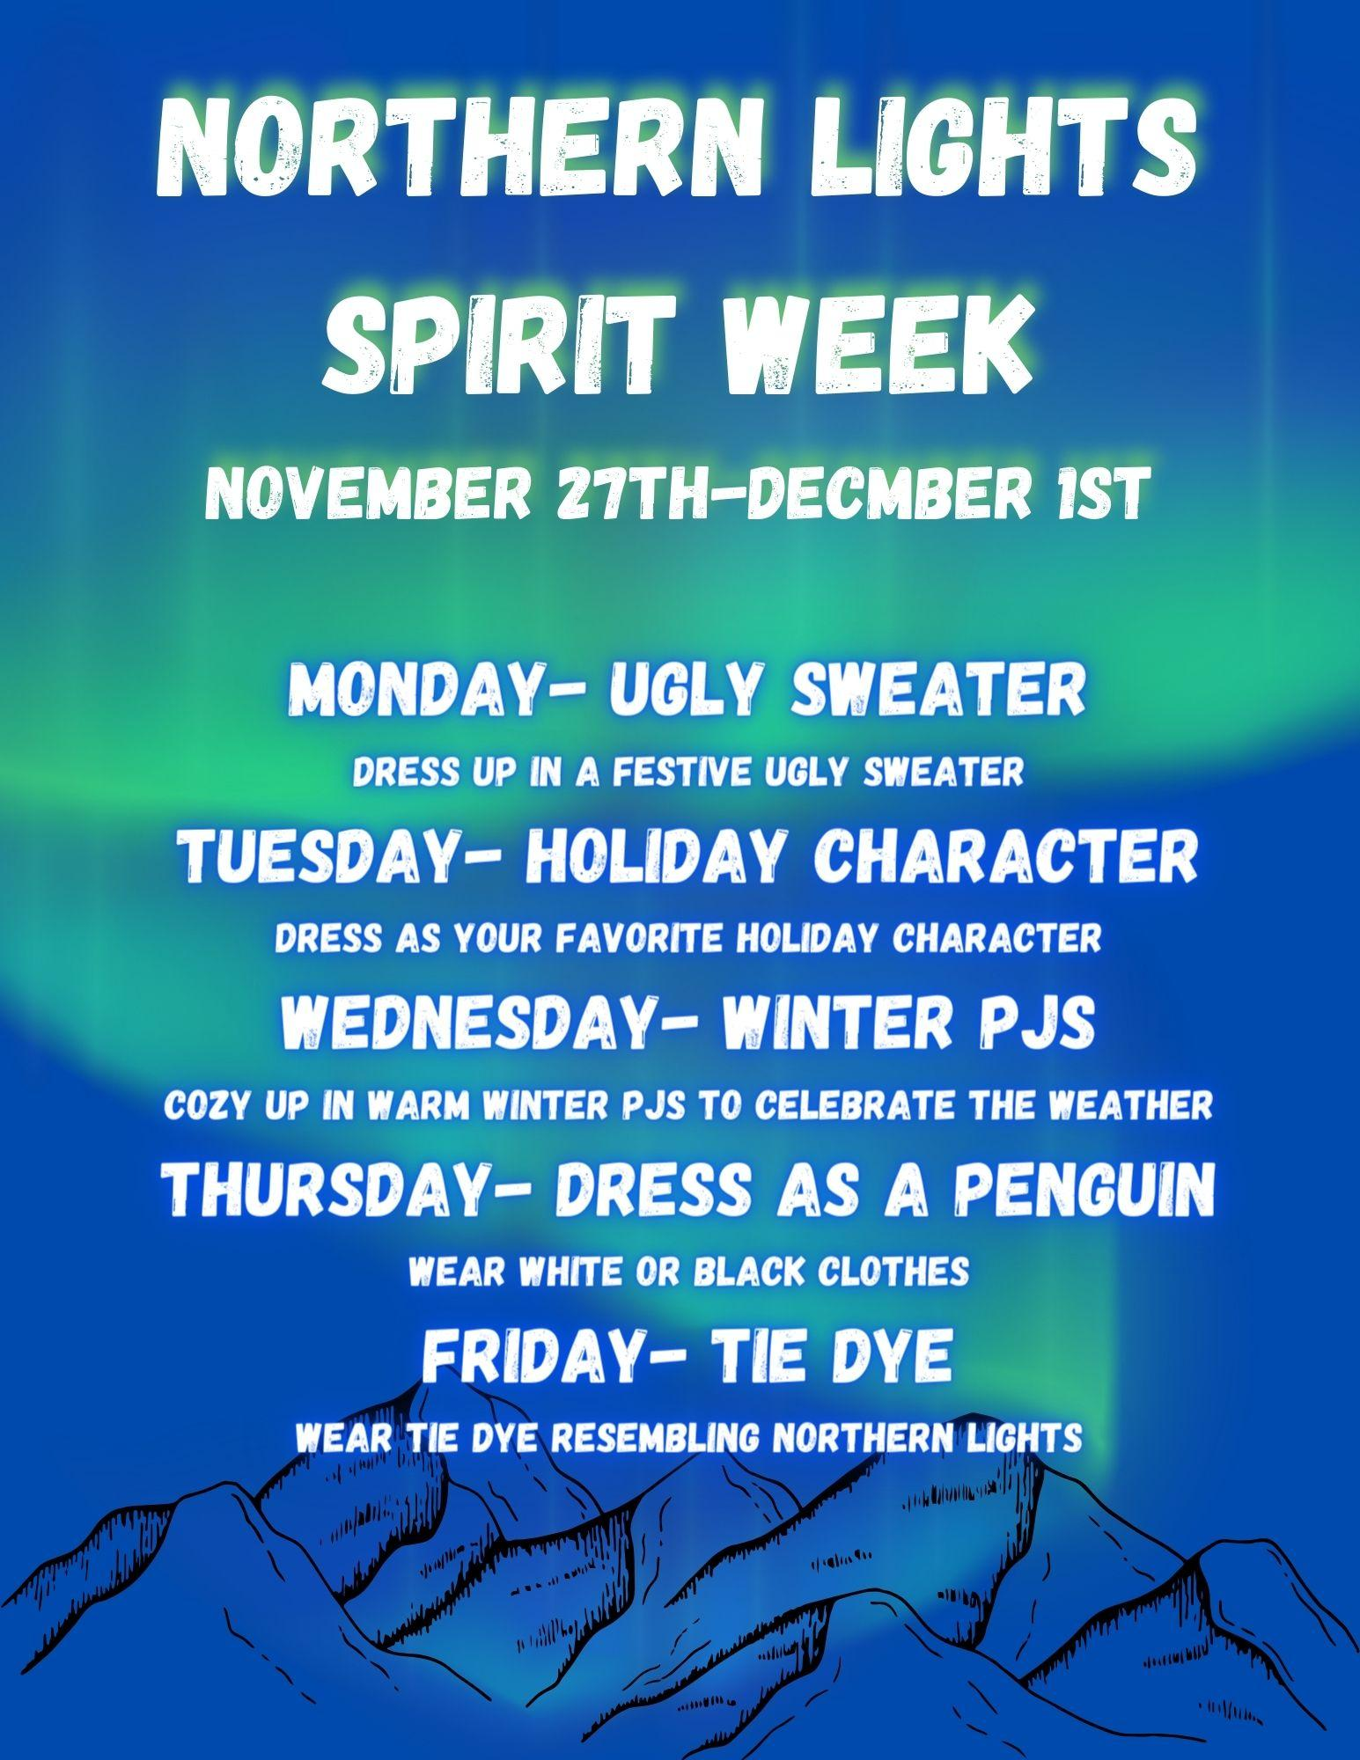

Slide 4

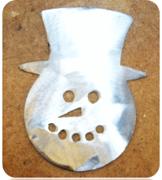
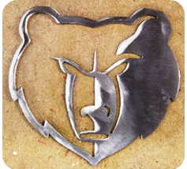
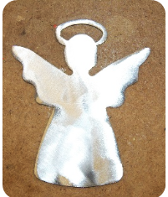

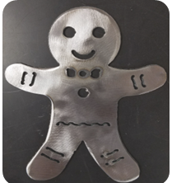
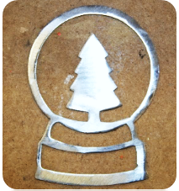

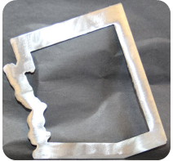


METAL ORNAMENTS FOR SALE $6
Order yours today with Mr. Hartfield (H118)
Color options available!
Cash, Check, or
Card accepted
Orders will be ready by the end of the semester.

Slide 5
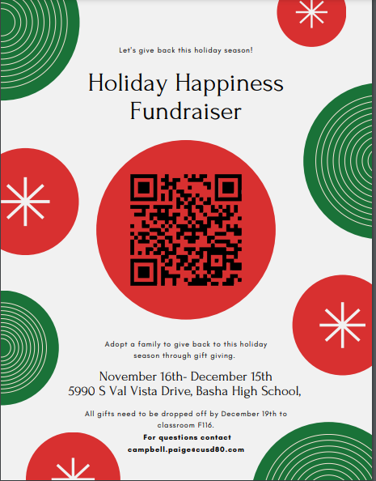

Slide 6
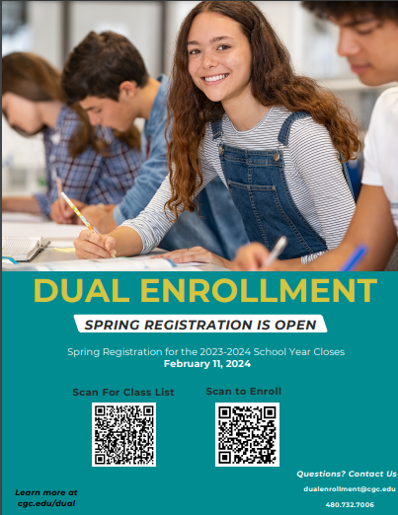

Slide 7

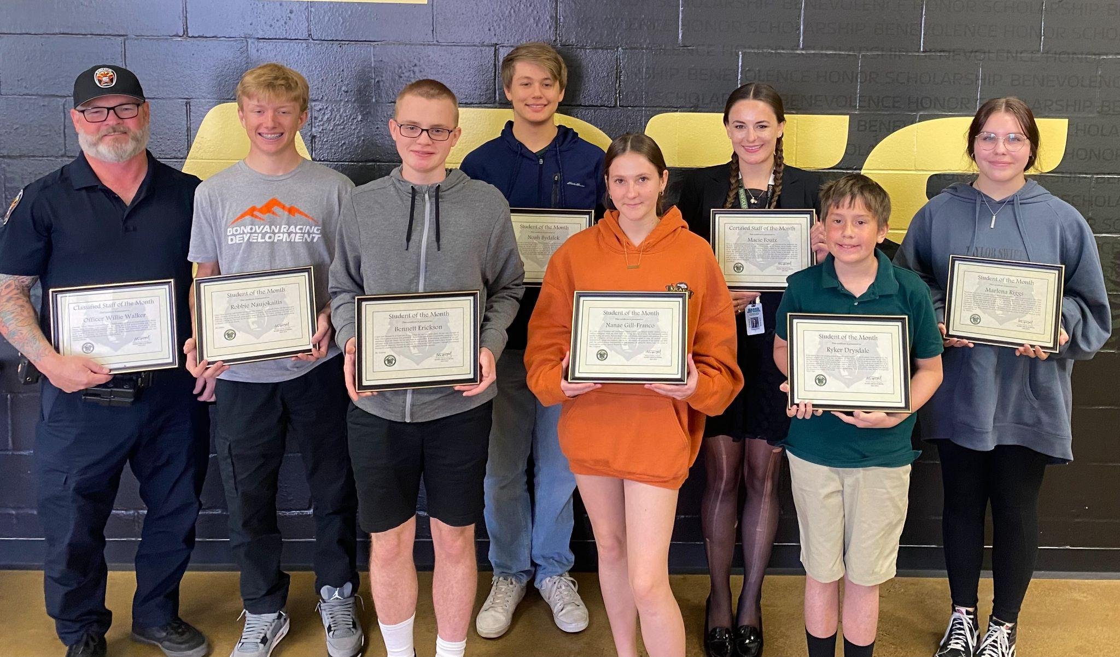
Congratulations to our Student/Staff of the Month winners!
Officer Willie Walker, Robbie Naujokaitis, Bennett Erickson, Noah Bydalek, Nanea Gill-Franco, Macie Foutz, Ryker Drysdale, and Marlena Riggs

Slide 8

SENIORS
Don’t delay purchasing your CAP & GOWN for graduation!
Go to Jostens.com and purchase yours today!

Slide 9


Slide 10


Slide 11

Seal of Biliteracy Applications are due Friday, December 1st!
For those students who received a 3 or better on the AP foreign Language exam and If you are wanting to apply for the seal of biliteracy, please do so by this FRIDAY!!!
Seniors, follow the link below:
Teaching & Learning / Seal of Biliteracy (cusd80.com)
Freshman, Sophomore, and Juniors follow the link below:
CUSD Seal of Biliteracy Intent to Participate Form (google.com)
The Arizona Seal of Biliteracy recognizes high school students who achieve proficiency in English plus at least one additional language. The seal is placed on the student’s diploma and noted on the transcript.

Slide 12


Slide 13
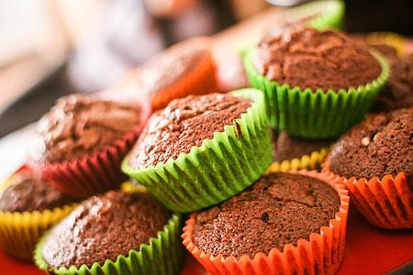

MUFFINS FOR SALE
$2
After 1st and 2nd hour in the breezeway

Slide 14

Students!
You must have your parking tag hanging on your rearview mirror. Cars without a parking tag will be ticketed.
Students, please do not park in the Admin. Parking lot.
Thank you.

Slide 15


Slide 16
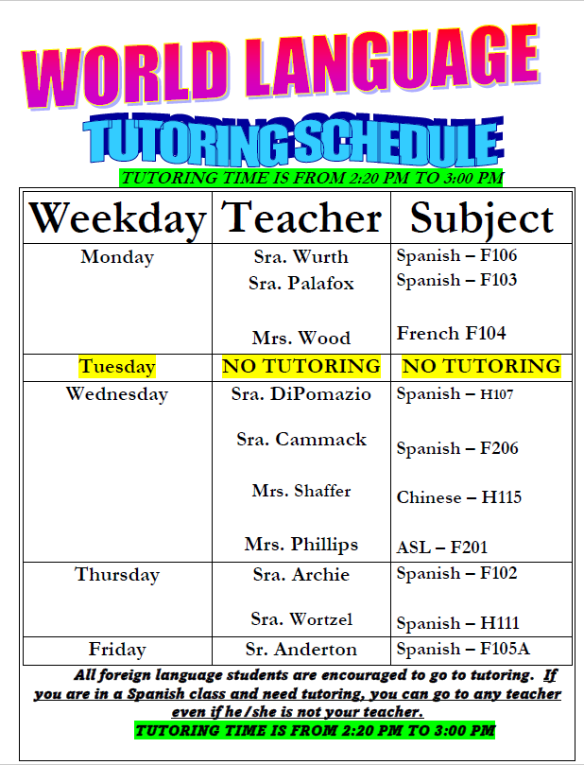

Slide 17

BASHA HIGH
does not accept food deliveries or food drop offs.
Thank you!

Slide 18

Mindfulness Room
Relax with guided meditation in the
Mindfulness Room
on
Fridays
7:05AM-7:20AM

Slide 19

Free or Reduced Meals
Do you know if you’re eligible for free or reduced-priced school meals? Were you eligible last year? Applications must be submitted each school year. Visit myschoolapps.com to complete an application.

Slide 20

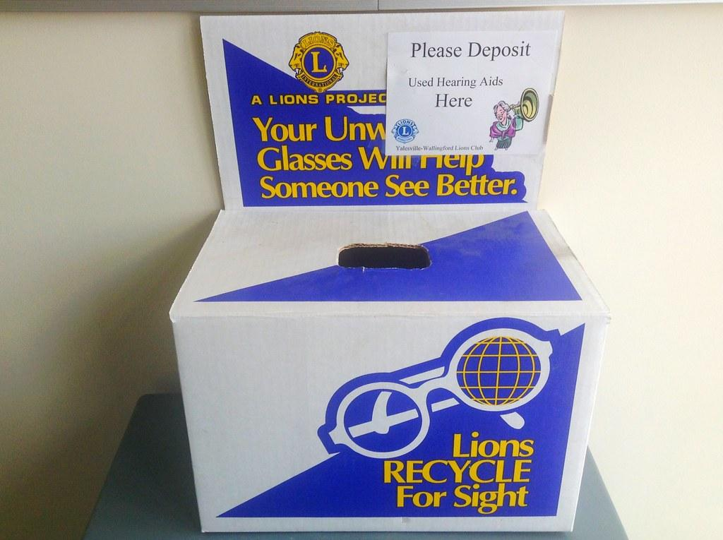
Your unwanted glasses will help someone see better!
DONATE today! The box is located in the Admin building @Kalli’s desk.

